Slide 1
Unit – 03 Introduction to Machine Learning
Introduction to Advanced Technologies
2104CS521
Prof. Vaseem Ghada
Master of Computer Application
vaseem.ghada@darshan.ac.in
9879531513

Slide 2
Introduction
Section - 1

Slide 3








What is Human Learning?
Human beings learn from the past experiences.
Human beings receive training at early stage of life to walk, speak, think, etc.

Slide 4

ML System
Traditional Programming System
ML Programming System
Data
Output
Program
Data
Program
Output

Slide 5
Machine Learning
Machine learning is a sub-discipline of Artificial Intelligence.
Machine Learning is the field of study that gives computers the capability to learn without being explicitly programmed.
Machine Learning Algorithm
Model
Output
Training
Input Past Data
Learning From Data
Testing With New Data

Slide 6
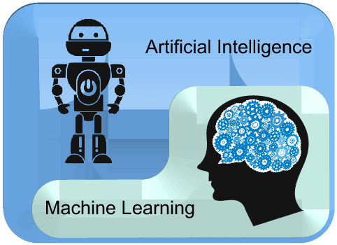
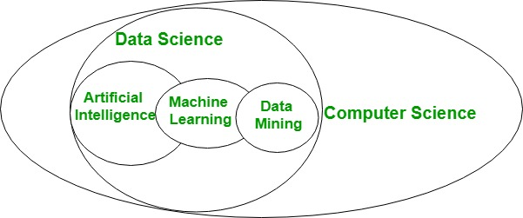
ML v/s AI
AI is a bigger concept to create intelligent machines that can simulate human thinking capability and behavior, whereas, machine learning is an application or subset of AI that allows machines to learn from data without being programmed explicitly.
Artificial intelligence is a technology using which we can create intelligent systems that can simulate human intelligence.

Slide 7
ML Applications
Medical Diagnosis
Stock Market Trading
Image Recognition
Speech Recognition
Online Fraud Detection
Email Spam Detection
Traffic Prediction
Product recommendation
Language Translation
Self Driving Car

Slide 8
ML Life Cycle
Gathering Data
Data Exploration
Data Preprocessing
Cleaning
Integration
Transformation
Reduction
Discretization
Model Selection
classification
clustering
Regression
Association Rule Mining
Train the model
Test the model
Model Evaluation
Data Collection
Model Evaluation
Data Exploration & Preprocessing
ML
Life Cycle
Test the Model
Model Selection
Train the Model

Slide 9
ML Life Cycle
Data Selection: Where data relevant to the analysis task are retrieved from the database.
Data Cleaning: To remove noise and inconsistent data.
Data Integration: Where multiple data sources may be combined.
Data Transformation: Where data are transformed or consolidated into appropriate forms for mining by performing summary or aggregation operations.
Model Selection: where we select the machine learning techniques such as Classification, Regression, Cluster analysis, Association, etc.
Model Training: Here with the training data set model is trained using ML algorithm.
Model Test: Here with the testing data set model is tested
Model Evaluation: Model Performance is evaluated using parameter matrices like: Accuracy, Precision, F-measure etc.

Slide 10
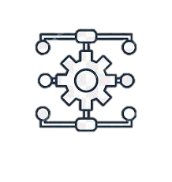


ML Terms
A method, function, or series of instructions used to generate a machine learning model.
Examples include linear regression, decision trees, support vector machines, and Naïve Bayes.
A Machine Learning Model is the learned program that maps inputs to predictions.
A model defines the relationship between features and label.
Models are created/learned when you train an algorithm on a dataset.
Algorithm
Model

Slide 11


ML Terms
With respect to a dataset, a feature represents an attribute and value combination.
A Feature is the input used for prediction or classification.
Feature selection is the process of selecting relevant features from a dataset for creating a Machine Learning model.
In supervised learning, a label is the "answer" or "result" portion of an example.
Each example in a labeled dataset consists of one or more features and a label.
Feature
Label

Slide 12


ML Terms
Training means creating or learning the model.
During training the model is given labeled examples.
Training enables the model to gradually learn the relationships between features and label.
Training Set is a set of observations used to generate machine learning models.
Testing means applying the trained model to unlabeled examples.
That is, you use the trained model to make useful predictions.
Training
Testing

Slide 13


ML Terms
The combination of a dataset with features and a target.
Depending on the type of the target, the task can be Classification, Regression, Analysis, Clustering, or Outlier detection.
The Prediction is what the machine learning model “guesses” what the target value should be based on the given features.
ML Task
Prediction

Slide 14
ML on which types of data
Database-oriented data sets and applications
Relational database, data warehouse, transactional database
Advanced data sets and advanced applications
Data streams and sensor data
Time-series data, temporal data, sequence data (incl. bio-sequences)
Structure data, graphs, social networks and multi-linked data
Object-relational databases
Heterogeneous databases and legacy databases
Spatial data and spatiotemporal data
Multimedia database
Text databases
The World-Wide Web

Slide 15
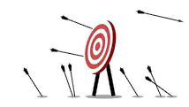

Classification of ML Techniques
Machine Learning
Supervised Learning
Unsupervised Learning
Reinforcement Learning
Task driven / predict next value
Data driven / identify clusters
Learn from mistakes

Slide 16
Classification of ML Techniques
Supervised learning is the types of machine learning in which machines are trained using well "labelled" training data, and on basis of that data, machines predict the output.
Unsupervised learning is a type of machine learning in which models are trained using unlabeled dataset and are allowed to act on that data without any supervision.
Reinforcement learning is an autonomous, self-teaching system that essentially learns by trial and error. It performs actions with the aim of maximizing rewards, or in other words, it is learning by doing in order to achieve the best outcomes.

Slide 17

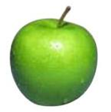
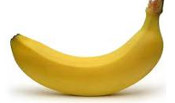
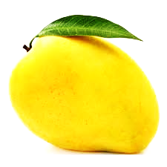
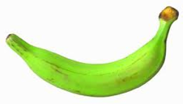

Supervised Learning
Training Dataset
Apple
Apple
Banana
Labeled examples
Mango
Banana
Mango

Slide 18

Supervised Learning
Training Dataset
Apple
Apple
Banana
Mango
model/
predictor
Banana
Mango

Slide 19
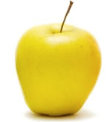
Supervised Learning
Predicted
label
Testing Data
model/
predictor

Slide 20
Supervised Learning
Training data
Test data
Apple
Apple
Predicted
label
Banana
Mango
model/
predictor
Banana
Given labeled examples, Train the model, Classify new unlabeled example
Mango

Slide 21
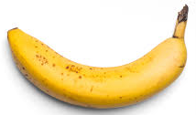
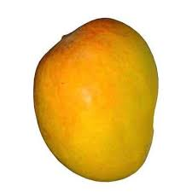
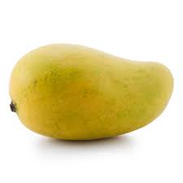
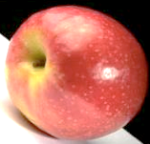
Un-Supervised Learning
Training Dataset
Unlabeled examples

Slide 22
Un-Supervised Learning
Training Dataset
model/
predictor

Slide 23
Un-Supervised Learning
Training Dataset
model/
predictor

Slide 24
Un-Supervised Learning
Test Data
model/
predictor
Given unlabeled examples, model creates clusters, maps the new unlabeled example to nearest cluster

Slide 25
Supervised Learning v/s Un-Supervised Learning
Supervised Learning | Unsupervised Learning
Algorithms are trained using labelled data. | Algorithms are trained using unlabelled data.
It takes direct feedback to check if it is predicting correct output or not. | It does not take any feedback.
It predicts the output. | It finds the hidden patterns in data.
input data is provided to the model along with the output. | In unsupervised learning, only input data is provided to the model.
The goal of supervised learning is to train the model so that it can predict the output when it is given new data. | The goal of unsupervised learning is to find the hidden patterns and useful insights from the unknown dataset.
It can be categorized in Classification and Regression problems. | It can be classified in Clustering and Associations problems.
It produces an accurate result. | It may give less accurate result as compared to supervised learning.
It includes various algorithms such as Linear Regression, Logistic Regression, Support Vector Machine, Multi-class Classification, Decision tree, Bayesian Logic, etc. | It includes various algorithms such as Clustering, KNN, and Apriori algorithm.

Slide 26
Reinforcement Learning
Place a reinforcement learning algorithm into any environment and it will make a lot of mistakes in the beginning.
The algorithm is provided with some sort of signal that associates good behaviors with a positive signal and bad behaviors with a negative one.
We can reinforce our algorithm to prefer good behaviors over bad ones. Over time, our learning algorithm learns to make less mistakes than it used to.
Environment
Action
State
Reward
Agent

Slide 27
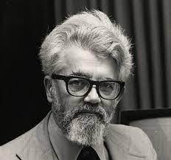
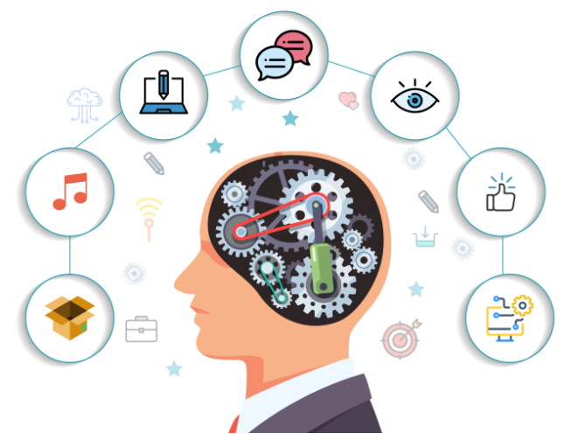
What is Artificial Intelligence?
The term “Artificial Intelligence” was actually coined way back in 1956 by John McCarthy, a professor at Dartmouth.
AI is the science and engineering of making intelligent machines.
AI is a branch of computer science dealing with the simulation of intelligent behavior in computers.
AI is the study of how to make computers do things which, at a moment, people do better.

Slide 28
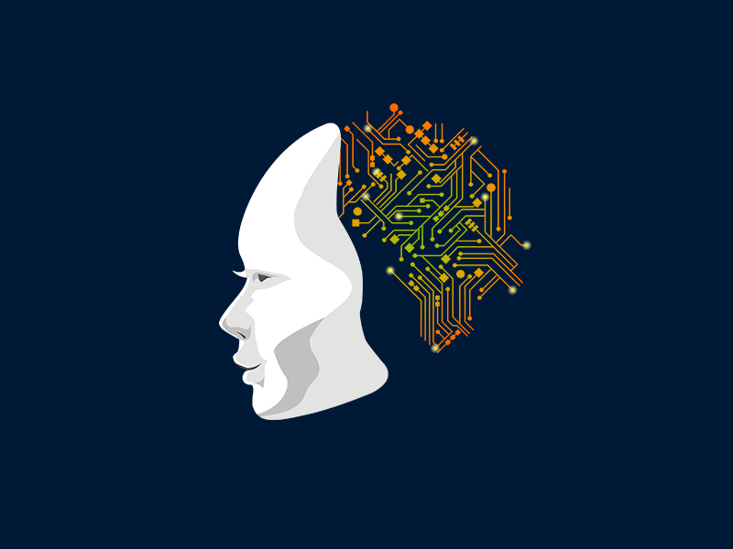
What is Artificial Neural Network?
Artificial Neural Network (ANN) is an efficient computing system whose working principle is borrowed from the analogy of biological neural networks of human brain.
The human brain is a highly complex, nonlinear, and parallel information-processing system.
It has the capability of organizing neurons so as to perform certain computations (e.g. pattern recognition, perception, and motor control) many times faster than the fastest digital computer.
A brain has great structure and the ability to build up its own rules through what we usually refer to as experience.

Slide 29
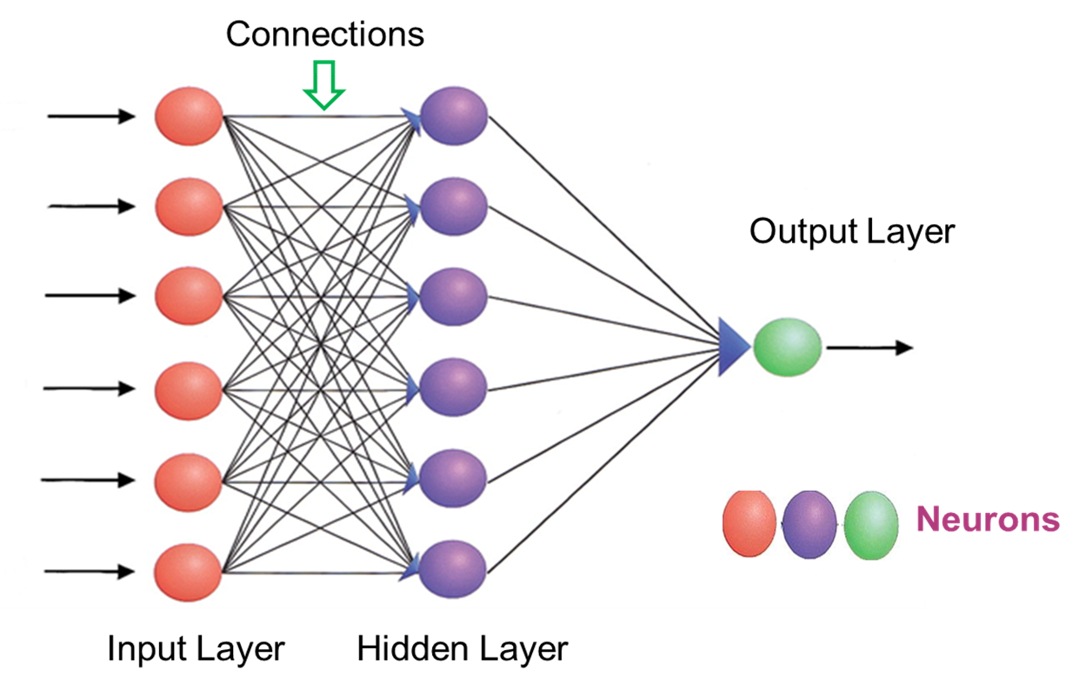
How ANN works?
The network starts with an input layer that receives input in the form of data.
The lines connected to the hidden layers are called weights, and they add up on the hidden layers.
Each dot in the hidden layer processes the inputs, and it puts an output into the next hidden layer and lastly, into the output layer.
A neural network is a system of hardware or software patterned after the operation of neurons in the human brain.
Neural networks, also called artificial neural networks, are ways of achieving deep learning.

Slide 30
Characteristics of Artificial Neural Network
It is basically a mathematical model.
It contains huge number of interconnected processing elements called neurons to do all operations.
Information stored in the neurons are basically the weighted linkage of neurons.
The input signals arrive at the processing elements through connections and connecting weights.
It has the ability to learn, recall and generalize from the given data by suitable assignment and adjustment of weights.
The collective behavior of the neurons describes its computational power, and no single neuron carries specific information.

Slide 31
Example of Artificial Neuron Network
Let’s take the below network with the given input and calculate the net input neuron and obtain the output of the neuron Y with activation function as binary sigmoidal.
The input has 3 neurons x1, x2 and x3, and single output Y.
The weights associated with the inputs are: {0.2, 0.1, -0.3}
Inputs= {0.3, 0.5, 0.6}
0.4
x1
0.2
0.3
x2
0.1
Y
0.7
x3
-0.3

Slide 32
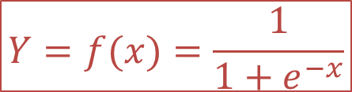
Example of Artificial Neuron Network
The weighted sum of Inputs means the “product of the weight of input and value of input” summed together for all inputs.
Net input ={x1*w1+x2*w2+ x3*w3}
Net input = (0.4*0.2) + (0.3*0.1) + (0.7*-0.3)
Net input X = -0.07
Output for Binary Sigmoidal
$$Y=f(x)=\frac{1}{1+e^{−x}}$$
0.4
x1
0.2
0.3
x2
0.1
Y
0.467
0.7
x3
-0.3

Slide 33
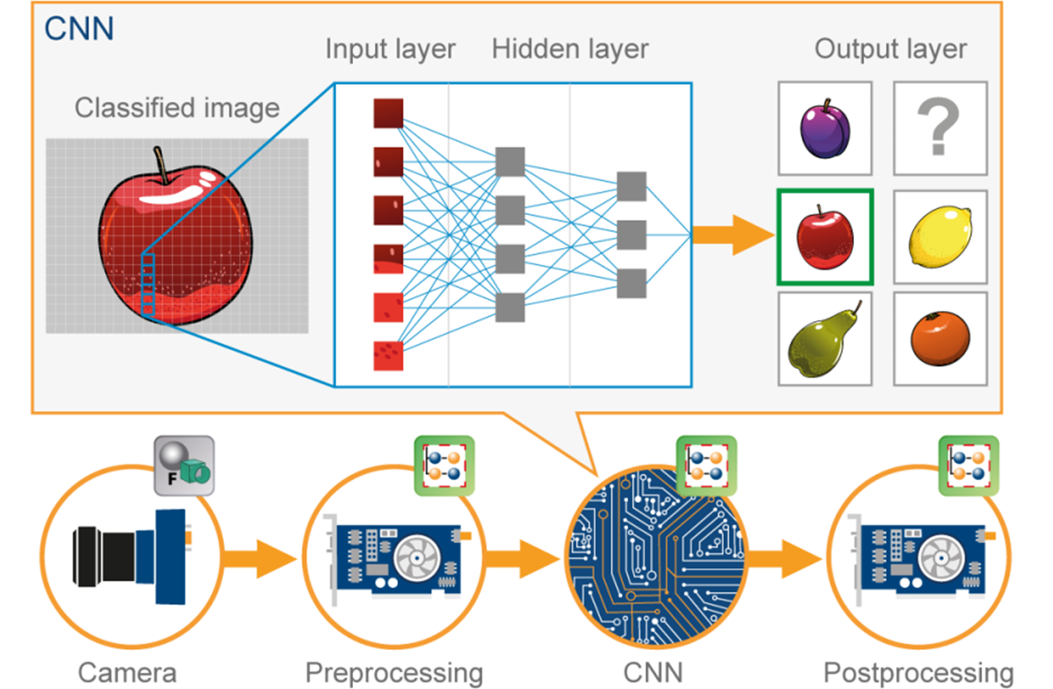
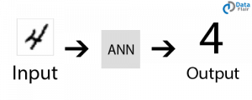
Applications of ANN
Image Processing and Character recognition:
ANN has an ability to take in a lot of inputs, process them to infer hidden as well as complex, non-linear relationships, ANNs are playing a big role in image and character recognition.
Character recognition like handwriting has lot of applications in fraud detection (e.g. bank fraud) and even national security assessments.
Image recognition is an ever-growing field with widespread applications from facial recognition in social media, cancer detention in medicine to satellite imagery processing for agricultural and defense usage.

Slide 34
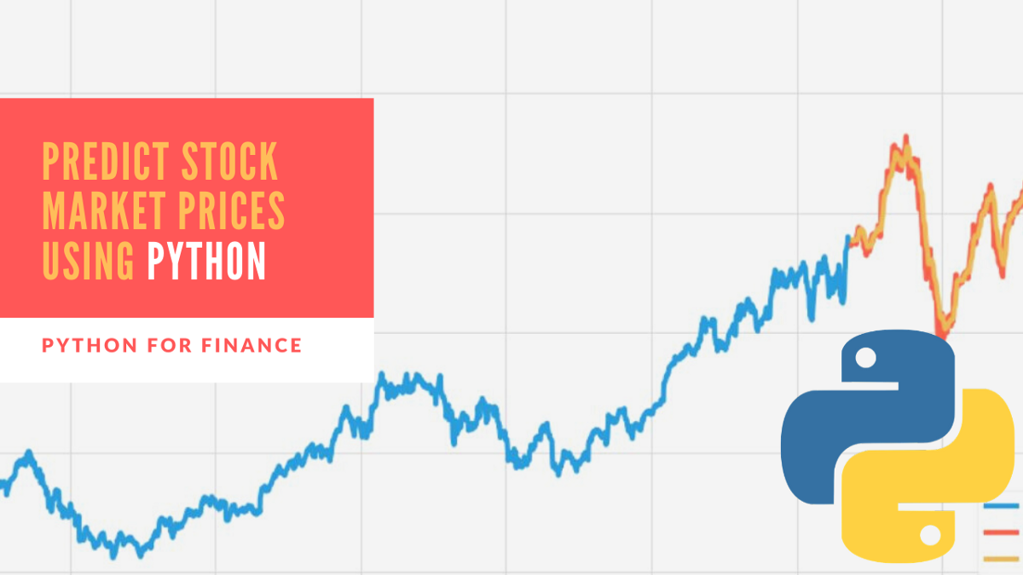
Applications of ANN
Forecasting:
Forecasting is required extensively in everyday business decisions (e.g. sales, financial allocation between products, capacity utilization), in economic and monetary policy, in finance and stock market.
More often, forecasting problems are complex, for example, predicting stock prices is a complex problem with a lot of underlying factors.

Slide 35
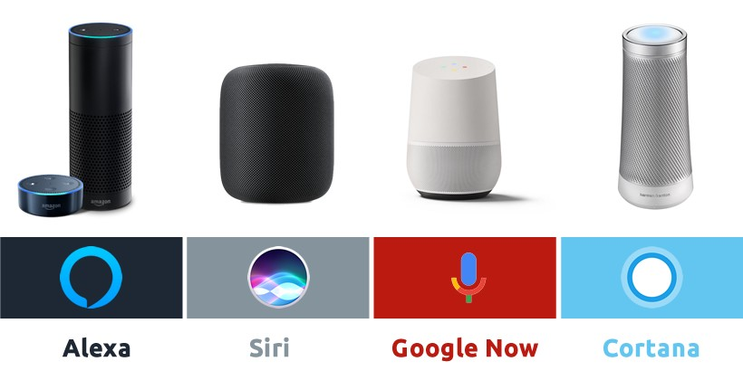
Applications of ANN
Speech Recognition:
Speech recognition has many applications, such as home automation, mobile telephony, virtual assistance, hands-free computing, video games, and so on. Neutral networks are widely used in this area.
We can say its a direct example of applications in virtual assistants or chatbots.
Nowadays, Google smart home, Alexa, Siri, Google assistance or Cortana are known to most of us.

Slide 36
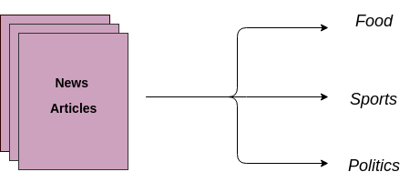
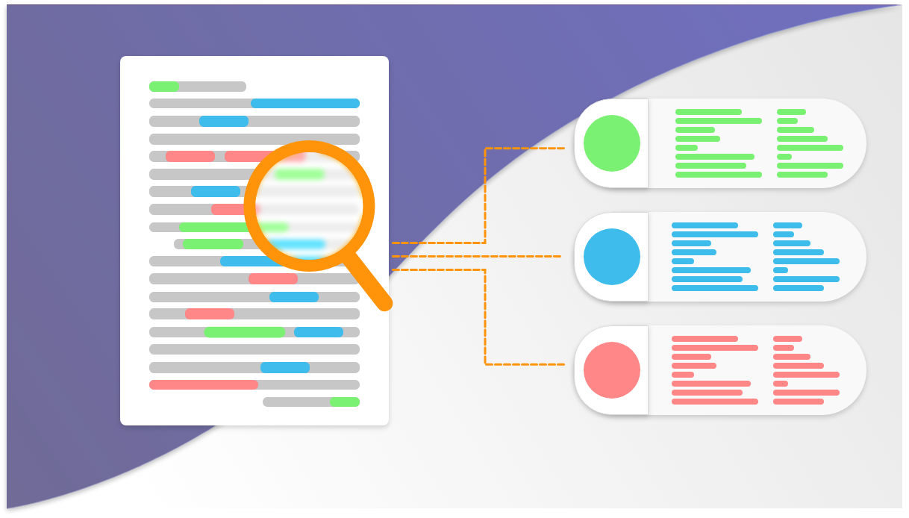
Applications of ANN
Text Classification and Categorization:
Text classification is an essential part of document search and filtering, online web searches and language identification and sentiment analysis.
Neural networks are actively used for this kind of task. Named entity recognition and parts of speech tagging are some of the application that comes under the domain of Natural Language Processing (NLP).
The widely used models are Recurrent Neural Networks (RNN) and Long-Short Term Memory (LSTM) networks. Though, CNN is also used for some of the applications.

Slide 37
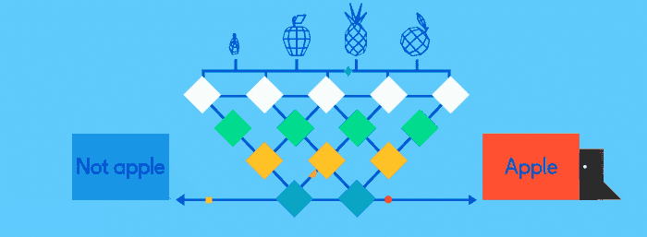
Applications of ANN
Image classification or labelling:
Convolution Neural Network or Feed-forward neural network with back-propagation is generally used for image classification. A model is selected based on the dataset for training and features of interest.
Transfer learning can be done using any pre-trained model if the dataset of your problem is similar to the dataset of the pre-trained model that you are choosing.
There are many pre-trained image classification models that are trained on millions of images of different hundreds and thousands of classes. Some of the models are ResNet, GoogLeNet, InceptionV3, VGG16, ImageNet and many more are available.
Image Source: https://towardsdatascience.com/activation-functions-neural-networks-1cbd9f8d91d6

Slide 38

Applications of ANN
Language Generation and Document Summarization:
Natural Language Generation and Paraphrasing and document summarization are widely used to generate the documents and summarize multi-documents.
Their applications can be found in generating text-based reports from data tables, automated reports writing, summarizing medical reports, generating stories and novels, etc.

Slide 39
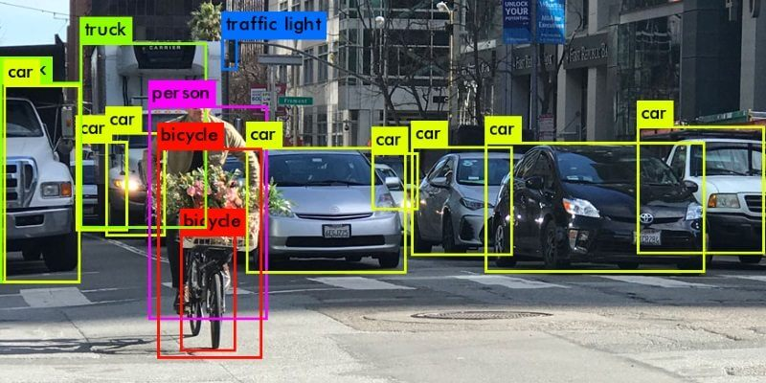
Applications of ANN
Object detection:
Object detection from images is widely used to detect any object and classify it based on that.
It needs large training dataset with all the coordinates of the object of interest clearly specified. The widely used object detection models are YOLO (You Only Look Once) and SSD (Single Shot Object Detectors).

Slide 40
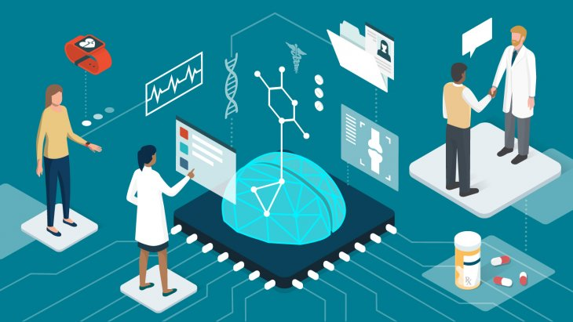
Applications of ANN
Healthcare:
Artificial Neural Networks are used in Oncology to train algorithms that can identify cancerous tissue at the microscopic level at the same accuracy as trained physicians.
Various rare diseases may manifest in physical characteristics and can be identified in their premature stages by using Facial Analysis on the patient photos.
So the full-scale implementation of Artificial Neural Networks in the healthcare environment can only enhance the diagnostic abilities of medical experts and ultimately lead to the overall improvement in the quality of medical care all over the world.

Slide 41
Thank You

